Slide 1

Loan management system

Slide 2
HISTROY OF MYSQL
MySQL ] is an open-source relational database management system (RDBMS).
"SQL", the acronym for Structured Query Language.
MySQL was created by a Swedish company, MySQL AB, founded by Swedes David Axmark and Allan Larsson, along with Finish Michael "Monty" Widenius. Original development of MySQL by Widenius and Axmark began in 1994.
MySQL is offered under two different editions: the open source MySQL Community Serverand the proprietary Enterprise Server.
MySQL Workbench is the integrated environment for MySQL. It was developed by MySQL AB, and enables users to graphically administer MySQL databases and visually design database structures.

Slide 3

MY SQL
DDL-Data Definition Language
DML-Data Manipulation Language
DQL-Data Query Language
TCL-Transaction Control Language
SQL STATEMENTS

Slide 4
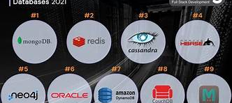
DATABASES
Oracle Database
MySQL
Microsoft SQL Server
PostgreSQL
MariaDB
IBM DB2.

Slide 5

Oracle SQL
MY SQL
A visual database design tool that integrates SQL development
A graphical tool for developing and managing Oracle databases
Free and open-source
SQL editor with syntax highlighting and auto-completion and Ability to connect to and manage multiple MySQL servers.
A graphical tool for developing and managing Oracle databases
Oracle, a commercial, enterprise-grade relational database management system.
Commercial product.
SQL editor with syntax highlighting and auto-completion and Database administration and management features

Slide 6
DATA TYPE SYSTEM
String Data Types
(VARCHAR, VARBINARY, TEXT)
Numeric Data Types
(INT, BIGINT, FLOAT, DOUBLE)
Date and Time Data Types
(DATE, DATETIME, TIMESTAMP, YEAR ,MONTH,DAY)
Blob Data Types
(TINYBLOB, MEDIUMBLOB, BLOB)

Slide 7

customer criteria based on applicant income
Set autocommit off;
Start transaction;
create table cust_grades select `Customer ID`, case when (ApplicantIncome > 15000) then "Grade A" when (ApplicantIncome > 9000) then "Grade B" when (ApplicantIncome > 5000) then "Middle Class Customer" else "Low Class Customer" end "Customer Grades",
case when (ApplicantIncome <5000 and Property_Area = "Urban") then 5 when (ApplicantIncome <5000 and Property_Area = "Semiurban") then 3.5 when (ApplicantIncome <5000 and Property_Area = "rural") then 3 when (ApplicantIncome <5000 and Property_Area = "semiurban") then 2.5 else 7 end "Montly_Interst_Percentage" from customer_income ;
FROM
CUSTOMER_INCOME

Slide 8
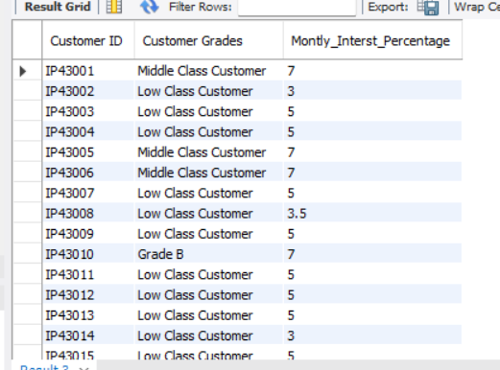
CODEINGS
output:
select * from cust_grades;

Slide 9
row level trigger for loan amount
create table Loan_detail1(Loan_Id varchar(50) ,Customer_Id varchar (50) , Loan_amount varchar(50) , Loan_amount_term int , Cibil_Score varchar(50) );
Delimiter $$
create trigger null_check before insert on loan_detail1 for each row
Begin
if new .Loan_amount is null then set new .Loan_amount = "Loan Still Processing";
end if;
end $$
delimiter ;
show triggers;
insert into Loan_detail1 select * from loan_status;
select * from loan_status;
From
loan_status

Slide 10

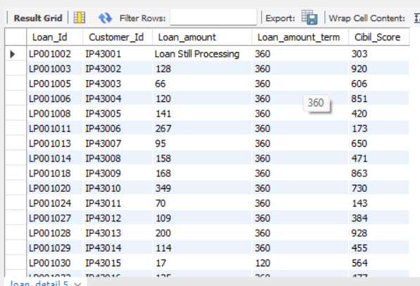
OUTPUT
select * from loan_detail;

Slide 11
From
sheet 2
create table Loan_cibil_detail_remaks(Loan_Id varchar(50) ,Customer_Id varchar (50) , Loan_amount varchar(50) , Loan_amount_term int , Cibil_Score varchar(50),primary key(customer_id));
show triggers;
create table Loan_cibil_detail_remaks1(customer_id varchar(50), cibil_score int ,cibil_score_remark varchar(50),primary key(customer_id));
delimiter $$
create trigger cibil_check_remark after insert on loan_cibil_detail_remaks for each row
begin
if new. Cibil_Score >900 then insert into loan_cibil_detail_remaks1 (customer_id ,cibil_score,cibil_score_remark) values (new.customer_id ,new .cibil_score ,"High cibil score");

Slide 12
-
From
sheet 2
elseif new. Cibil_Score >750 then insert into loan_cibil_detail_remaks1 (customer_id ,cibil_score,cibil_score_remark) values (new .customer_id ,new .cibil_score ,"No penalty");
elseif new. Cibil_Score >0 then insert into loan_cibil_detail_remaks1 (customer_id ,cibil_score,cibil_score_remark) values (new. customer_id ,new .cibil_score ,"penalty Customer");
elseif new. Cibil_Score <=0 then insert into loan_cibil_detail_remaks1 (customer_id ,cibil_score,cibil_score_remark) values (new .customer_id ,new .cibil_score ,"Reject Customer");
end if;
end $$
delimiter ;
insert into Loan_cibil_detail_remarks select * from loan_detail1

Slide 13
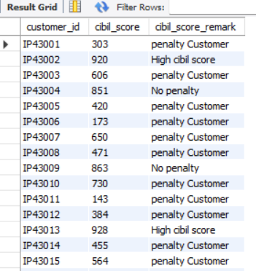
OUTPUT
SELECT * FROM loan_cibil_detail_remaks;

Slide 14
DELETE,MODIFY,CREATE TABLE
create table table_new select r.*,r1.cibil_score_remark from loan_cibil_detail_remaks1 as r1 inner join loan_cibil_detail_remaks as r on r1.customer_id = r.Customer_Id;
delete from table_new where Loan_amount = "loan still processing";
select * from table_new;
alter table table_new modify Loan_amount int;

Slide 15

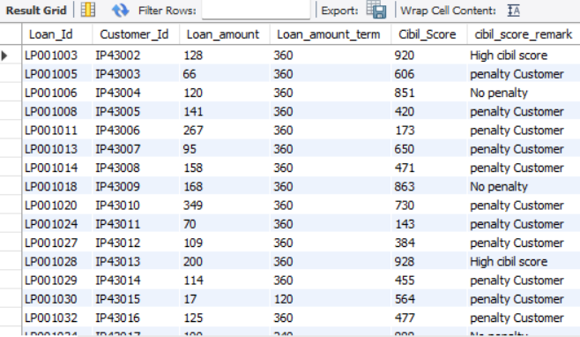
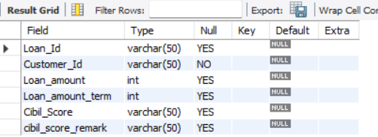
OUTPUT
DATASHEET 2
DELETE
MODIFY
CREATE TABLE

Slide 16
CALCULATING INTEREST,JOINS
create table table_new2 select Customer_Id,round(Loan_amount * Montly_Interst_Percentage) as monthly , round((Loan_amount * Montly_Interst_Percentage) * 12)as Annual
create table loan_cibil_score select i.*,new1.Loan_amount,new1.Cibil_Score, new1.cibil_score_remark,x1.`Customer Grades`,new1.Montly_Interst_Percentage,new2.
Annual,new2.monthly from customer_info as i inner join table_new1 as new1 on i.`Customer ID` = new1.Customer_Id inner join table_new2 as new2 on new1.Customer_Id = new2.Customer_Id;

Slide 17
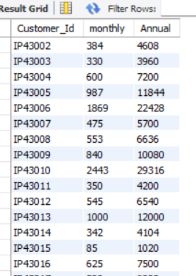
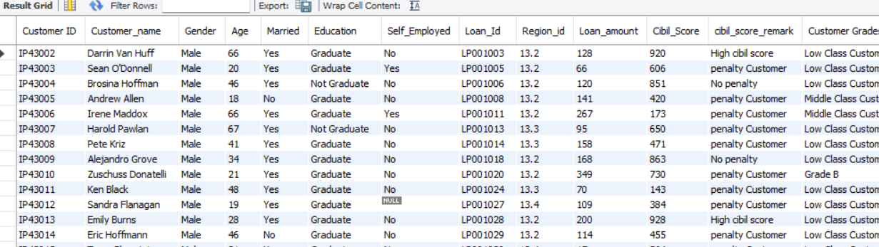
OUTPUT
-INTEREST CALUCATION
- TABLE CREATING

Slide 18
Update gender and age based on customer id AND ADDING REGION INFO
select s.* ,c.Region_id,c.Postal_Code,c.Segment,c.State,r.Region from loan_cibil_score as s inner join country_state as c on s.`Customer ID` = c.Customer_id inner join region_info as r on s.Region_id = r.Region_Id ;
From
SHEET 3 ,4 AND 5

Slide 19
THE END OF LOAN MANAGEMENT SYSTEM

Slide 20
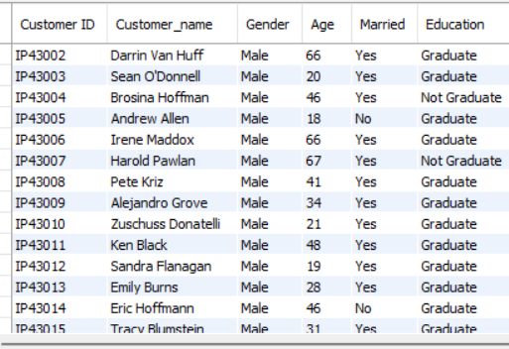
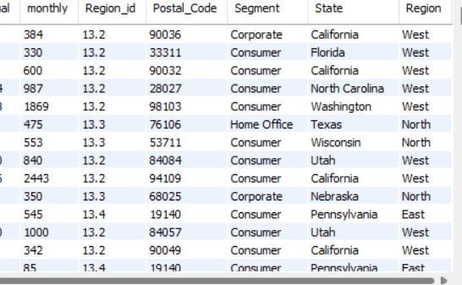
OUTPUT
FROM SHEET 3,4 AND 5
-GENDER AND AGE
-REGION

Slide 21
output
select * from output_1 ; -- output 1
select o.*,r.* from output_1 as o right join region_info as r on o.Region_id =r.Region_Id where o.Region_Id is null;
-- output 2select * from output_1 where cibil_score_remark = 'High cibil score’;
-- output 3select * from output_1 where Segment in ('home office','corporate'); -- output 4
FROM SHEETS
1,2,3,4 AND 5

Slide 22
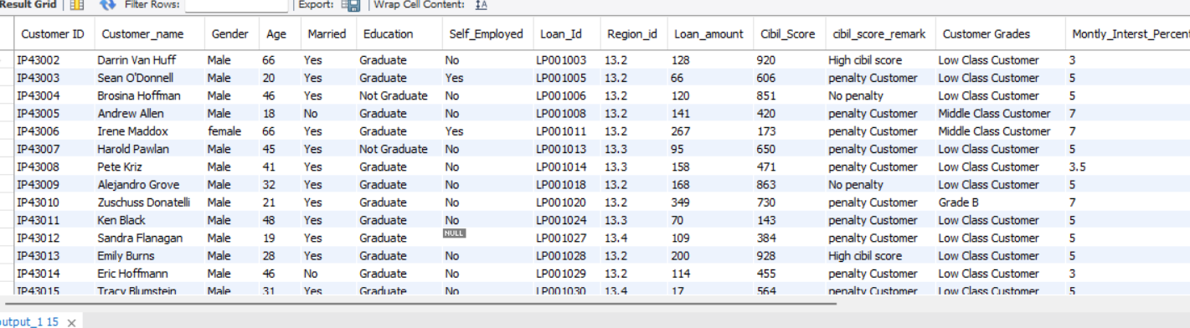
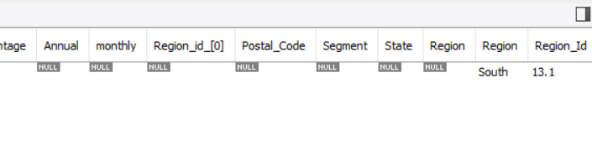
OUTPUTS
FROM SHEETS 1,2,3,4 AND 5
OUTPUT 1
OUTPUT 2

Slide 23
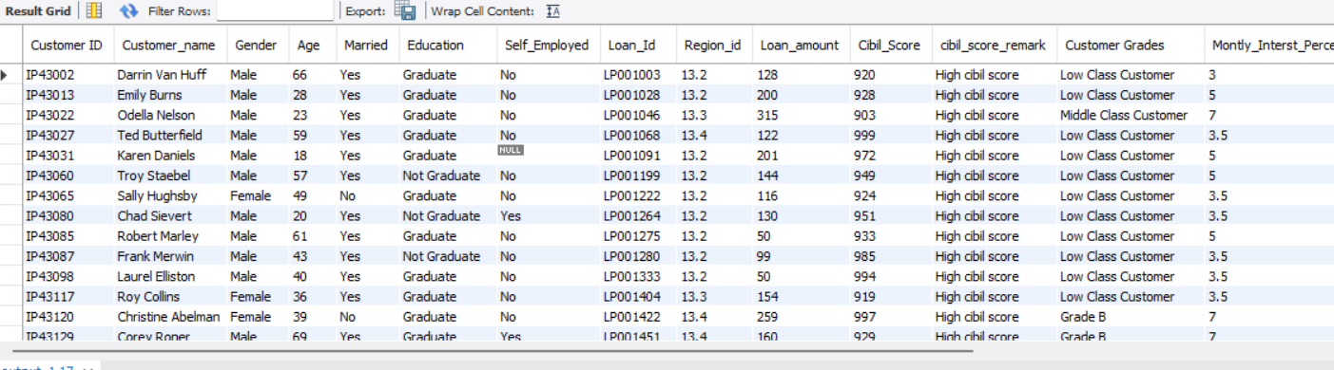
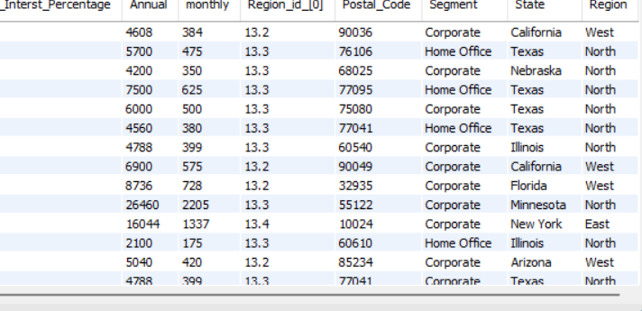
OUTPUTS
FROM SHEETS 1,2,3,4 AND 5
OUTPUT 3
OUTPUT 4

Slide 24
THE END LOAN MANAGEMENT SYSTEM

